Slide 1
The Practical Case for Quality: The Teacher and Student Perspective
Jenna Winter Royce Le
Dominic Griff Katie McConville
Mitch Leffler (ELA) Dana Dyer (Biology)
Bellevue School District Highline School District
Paul Teske, Katie Van Horne & Philip Bell Educurious, University of Washington
Unless otherwise specified, this work is licensed under a Creative Commons Attribution 3.0 United States License.
Cite as: Bell, P. (2012, January). The practical case for quality: The teacher and student perspective. Presentation at Conversations on quality: a symposium on k-12 online learning, Cambridge, MA.
Notes:
Cite as: Bell, P. (2012, January). The practical case for quality: The teacher and student perspective. Presentation at Conversations on quality: a symposium on k-12 online learning, Cambridge, MA.
Unless otherwise specified, this work is licensed under a Creative Commons Attribution 3.0 United States License.

Slide 2
Educurious Next Gen Courses & Units
• Engages students in relevant, authentic learning and projects
• Leverages principles of how and why people learn
• Uses a competency-focused, learner-centered technology platform
• Connects students with network of experts and professionals
Notes:
Designing year-long courses for 8th to 10th grade in Biology, Algebra and English / Language Arts
- Launched a non-profit with Steve Arnold & Michael Golden
- It a blended learning model—significant F2F and online components
Tell your story of getting to here and the importance of this work
Give our story in summary
Visit ourcorporate website for more info

Slide 3
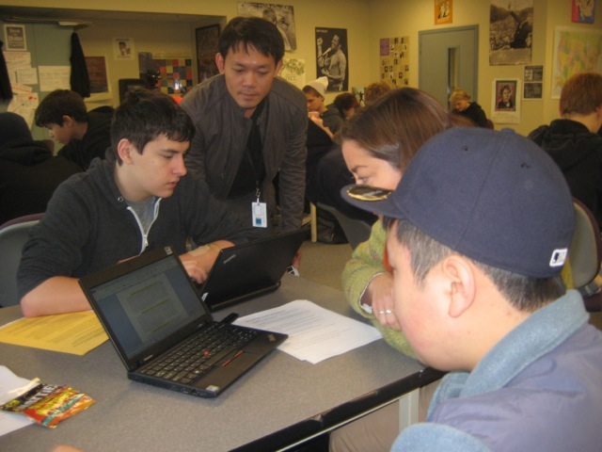
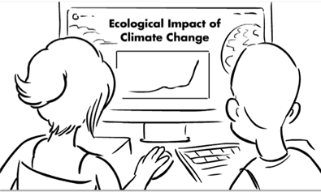
Contemporary, Relevant Projects
How do I get people to pay attention to my opinions?
How can I protect important ecosystems from the impacts of climate change?
How do infectious diseases constantly outsmart us and continue to threaten human populations around the globe?
What happened to Edgar Allan Poe?
How are mysteries constructed to tell a story that rivets an audience through suspense?
Notes:
- Authentic, sustained projects
We want to engage students in extended projects, learning “just in time” with more elective choice and specialization in multifunction teams

Slide 4
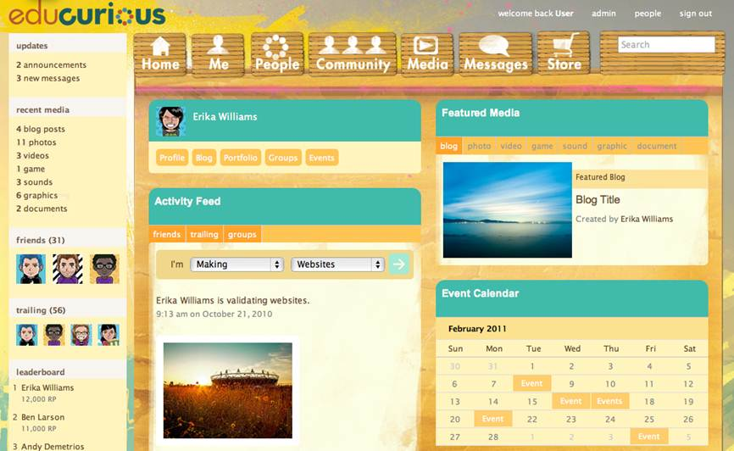
Social Learning Platform, Tools & Badges

Slide 5
The Educurious Expert Network (TEEN)
Offer the challenge
Visit classrooms virtually in various ways
Provide expertise and support to curriculum design teams
Give authentic feedback on student work
We are all products of our social networks.
Build volunteer network of domain experts / professionals
April Henry & Shareen’s Story
Notes:
Experts represented by pyramid in terms of levels and numbers
Two demonstration videos, one giving the challenge, another expert describing work and context
Question for HTH- How does expert collaboration show up in your school(s)? Internships? Externships? Unit involvement, planning? Industry collaboration? Are there any other ways professionals are involved in the work?

Slide 6
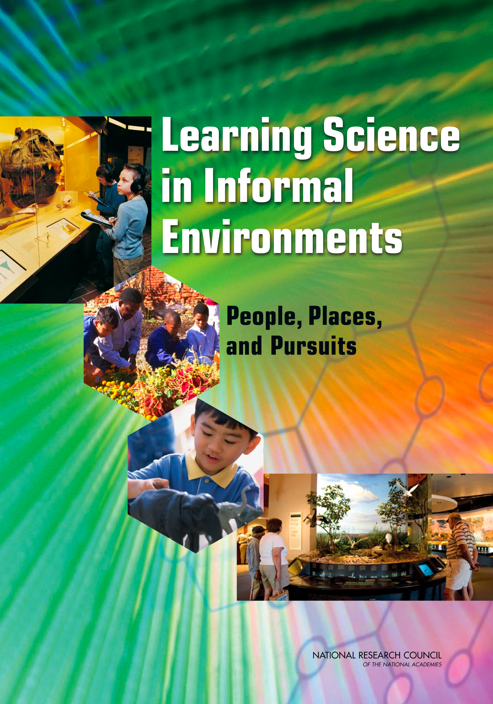
nap.edu
Notes:
6

Slide 7
Design Research with Learner Assessment
Engagement dynamics
Metacognitive assessment
Progress along competency-based learning pathways
Detailed video analysis of high-challenge learning moments
Orchestrated assessment (pre/post)

Slide 8
Panel Discussion Format
Topic: How Can Technology Be Used to Support Powerful Learning Experiences for Students
Topic: Reflecting on the Teaching & Learning Experience
Q&A

