Slide 1
Quality Courseware through Interactive Gaming
James Gee Arizona State University
Unless otherwise specified, this work is licensed under a Creative Commons Attribution 3.0 United States License.
Cite as: Gee, J. (2012, January). Quality courseware through interactive gaming. Presentation at Conversations on quality: a symposium on k-12 online learning, Cambridge, MA.
Notes:
Cite as: Gee, J. (2012, January). Quality Courseware through Interactive Gaming. Presentation at Conversations on quality: a symposium on k-12 online learning, Cambridge, MA.
Unless otherwise specified, this work is licensed under a Creative Commons Attribution 3.0 United States License.

Slide 2
Mark 2:22
And no one puts new wine into old wineskins. For the wine would burst the wineskins, and the wine and the skins would both be lost. New wine calls for new wineskins.

Slide 3
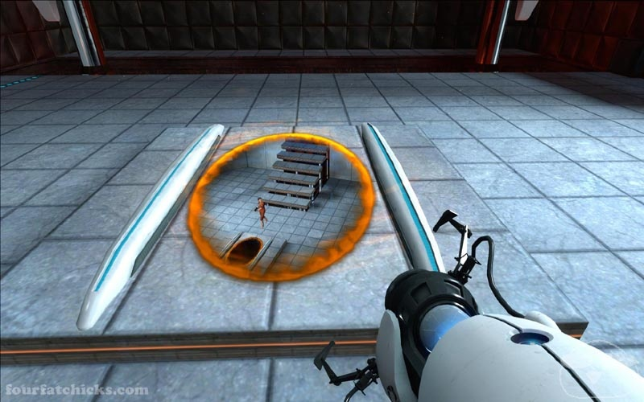

Slide 4
The portals create a visual and physical connection between two different locations in 3D space. Portal ends are restricted to planar surfaces, but if the portal ends are on nonparallel planes, bizarre twists in geometry and gravity can occur as the player character is immediately reoriented to be upright with respect to gravity after leaving a portal end. An important aspect of the game's physics is "momentum redirection". Objects retain the magnitude of their momentum as they pass through the portals but in a direction relative to the surface the exit portal is on. This allows the player character to launch objects, or even herself, over great distances, both vertically and horizontally, a maneuver referred to as "flinging" by Valve. [http://en.wikipedia.org/wiki/Portal_(video_game)—11/22/07]

Slide 5
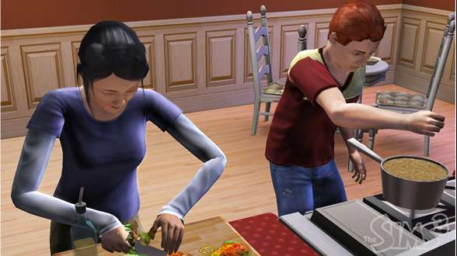

Slide 6
Sims 2: Nickel and Dimed Challenge
This challenge was inspired by, and is named for, the book Nickel and Dimed by Barbara Ehrenreich (which has nothing whatsoever to do with Sims, but is nevertheless highly recommended). The idea is to mimic, as closely as possible, the life of an unskilled single mother trying to make ends meet for herself and her kids.

Slide 7
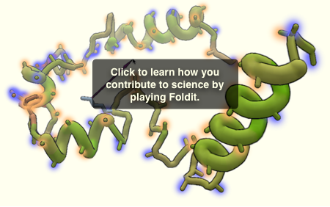
FOLDIT

Slide 8
Dane2010, I've thought about this same subject many times. You're absolutely correct. Since the depiction of the protein is a graphical representation of three-dimensional space, it is easy to understand the relationship of distance to force. Since the effects of the push/pull of one atom on another are invisible, it is much more difficult to depict or understand.
I wonder if Fold.it, redesigned as a Wii type game might allow us to push/pull and 'feel' our way to better solutions?

Slide 9
Curriculum + Affinity Space
=
Affinity Learning
=
a-learning not e-learning

Slide 10
1
Well ordered, well designed, well mentored problem space

Slide 11
2
Information, facts, and formulas used as tools for understanding and problem solving

Slide 12
3
Interactive =
Conversation with Intelligent Replies

Slide 13
4
Situated meanings = words and texts associated with images, actions, experiences, dialogue, and goals, not just other words and texts

Slide 14
5
Words and Texts “Just in Time”
and “On Demand

Slide 15
6
Production = People produce and do not just consume, participate and not just spectate = Pro-Ams

Slide 16
7
Modding = Students can “mod” the curriculum and transform parts of it or build new parts of it

Slide 17
8
Adaptation + Persistence Past Failure

Slide 18
9
Data Mining + Useful Representations for Assessment of Growth Across Time and Different Trajectories Towards Mastery

Slide 19
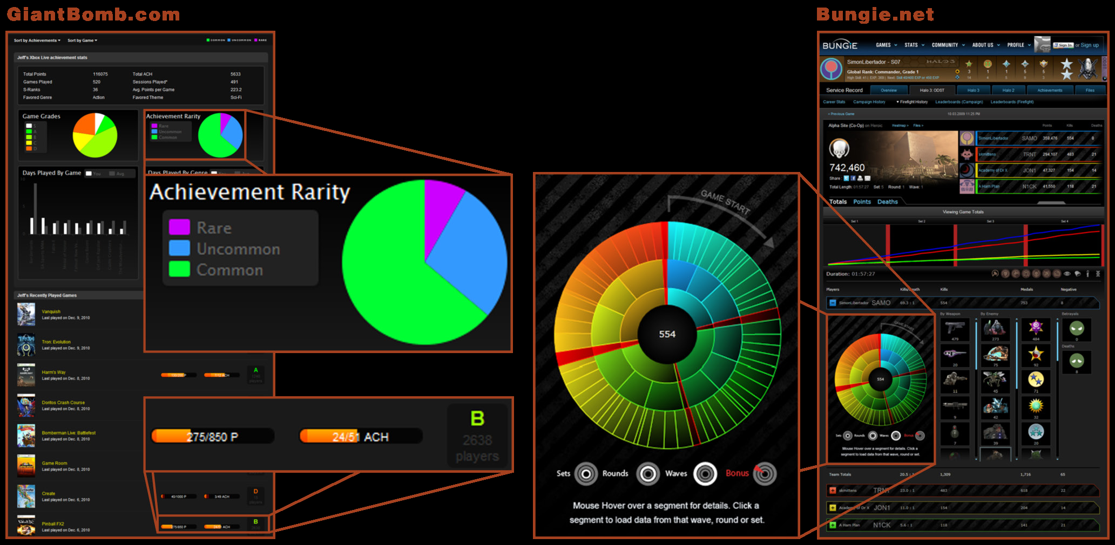

Slide 20
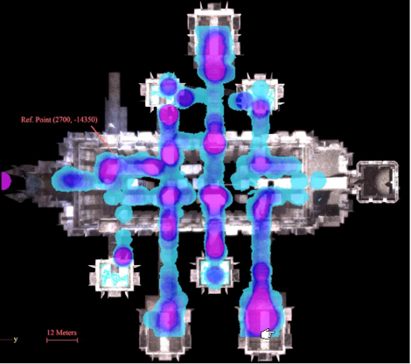

Slide 21
10
Learning and Assessment Integrated = Can’t Finish Without Having Achieved Mastery

Slide 22
11
Transfer =
Preparation for Future Learning

